Slide 1
PAC Meetings Presentation
Pine Island High School

Slide 2
THINGS THAT MUST BE DONE BEFORE STUDENTS CAN PRACTICE!
Current Physical on File (good for 3 years)
Registration completed through Pine Island website and RevTrak
Eligibility Brochure (each year)
Sports Fee Paid: $105 per sport (9-12) $80 (7-8) with $425 family max)

Slide 3
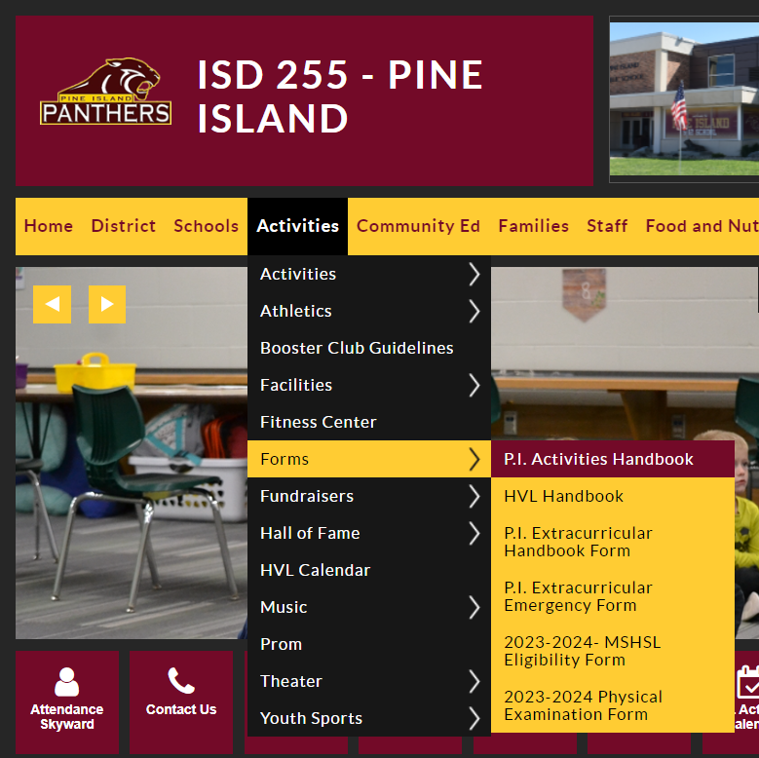
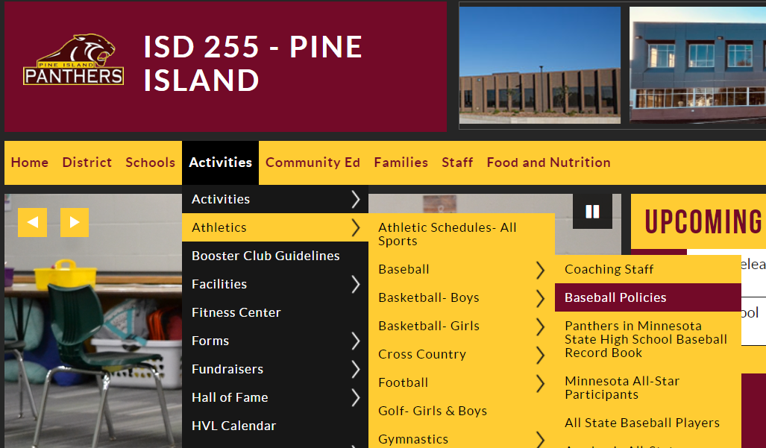
Read the specific sports handbook
Access to P.I. Activities Handbook

Slide 4
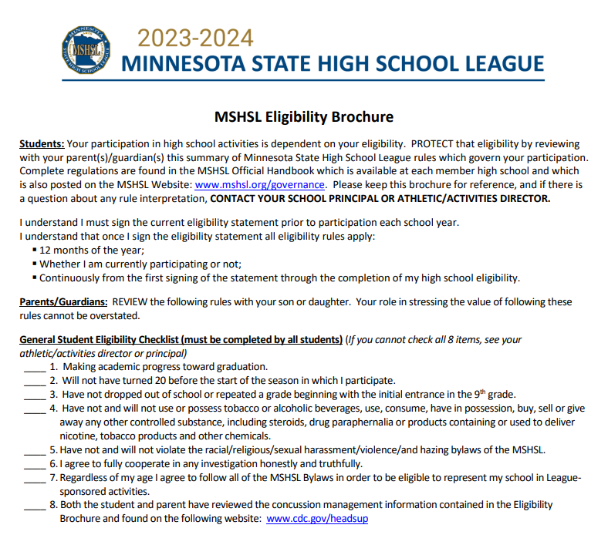
ENSURE THAT YOU READ AND UNDERSTAND THE ELIGIBILITY BROCHURE!!!!!

Slide 5
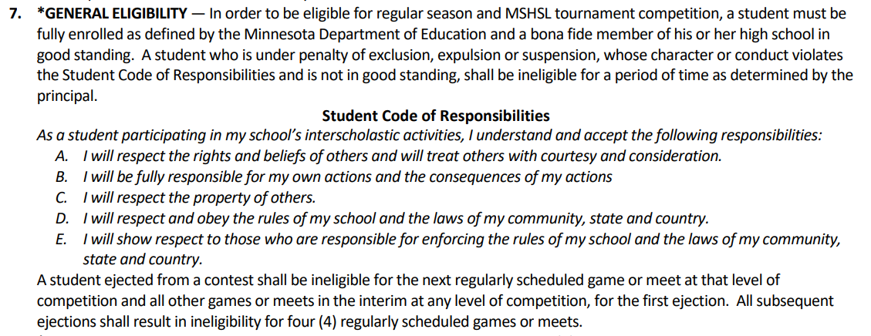
MSHSL Form………Code of Responsibilities

Slide 6
STEPS FOR PARENTS/STUDENTS TO FOLLOW TO SOLVE A CONCERN OR ISSUE
Make it a point to NOT try to solve issues just before or just after a game/contest!
First, student should talk to the coach directly. This may not result in a mutually agreed upon solution, but will result in a better understanding of each other’s viewpoint.
Second, if not resolved student and parent should meet with coach together.
Third, if not resolved the parent, student, coach and AD should meet.

Slide 7
HELPFUL THINGS TO KNOW AND DO AS A PARENT AND STUDENT
Get to know the coach.
Know the team and school policies found in the Team and Coaches Handbooks.
Know the academic eligibility policy
Know the team schedule and bus departure times. (found on PI activities calendar)
Sign Up for the “Notify Me” option on the activities calendar Site for up to date changes.
Support the team and understand the importance of team / student roles.
Know your student’s coach’s intent for communication (how often and content)

Slide 8
Benefits of Co-curricular or Education-based Activities
Activities Support the Academic Mission of Schools. They are not a diversion, but rather an extension of a good educational program. Students who participate in activity programs tend to have higher grade-point averages, better attendance records, lower dropout rates and fewer discipline problems than students generally.
Activities are Inherently Educational. Activity programs provide valuable lessons and skills for practical situations – like teamwork, fair play, and hard work. Through participation in activity programs, students learn self-discipline, build self-confidence and develop skills to handle competitive situations. These are qualities students need if they are to become responsible adults, productive citizens and skilled professionals.

Slide 9
Activities Promote Health and Well-being. Mental and physical health are improved by through activities. Self-concept, self-image, physical activity, and weight management are a few of these health benefits realized through activity participation.
Activities Foster Success in Later Life. Participation in high school activities is often a predictor of later success – in college, a career and becoming a contributing healthy member of society.

Slide 10
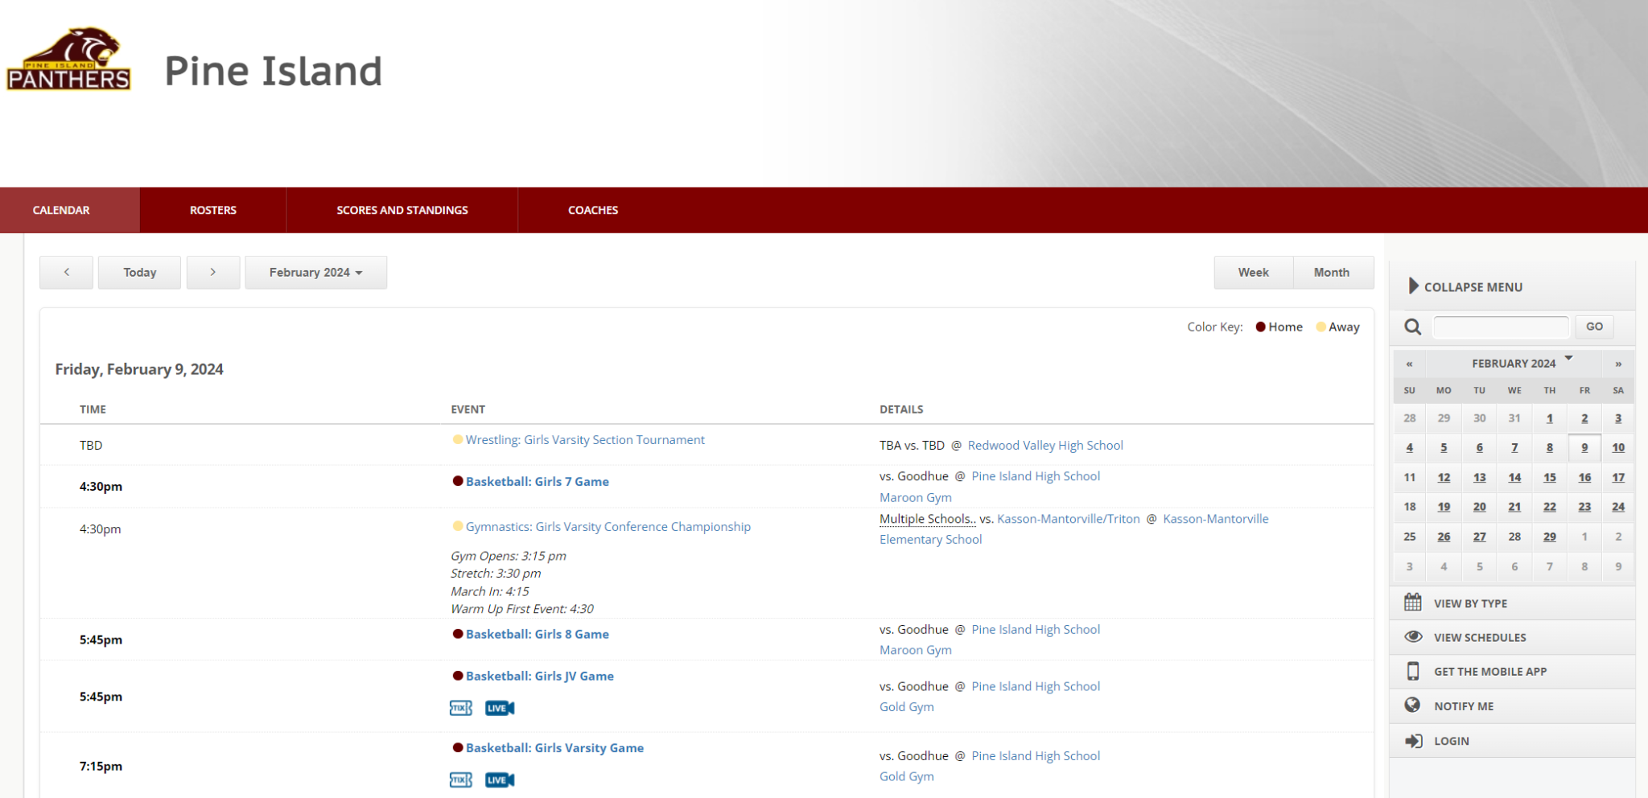
Activities Calendar

Slide 11
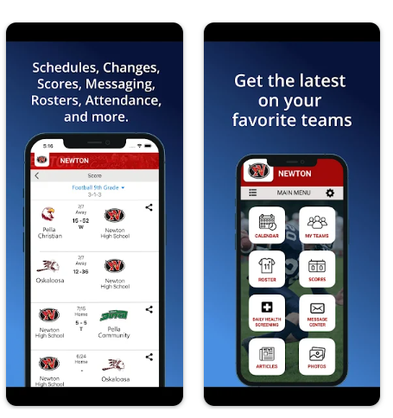
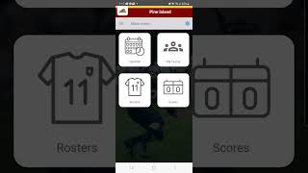
Activities Scheduler App

Slide 12
Attendance Policy
Members of any extracurricular activity are expected to be at every practice or activities session unless they are absent due to illness or are excused in advance. Participants who violate school attendance regulations are subject to temporary suspension from participating. Any student who is absent from school for more than 1/2 day will not be allowed to participate in an activity after school that day unless participation has been approved by the principal for extenuating circumstances. Likewise, a student participating in an activity is expected to be in school that next morning.

Slide 13
SUPERVISE YOUR YOUNG CHILDREN!

Slide 14
Case Study: What do athletes want from their coaches and parents?
IN THE SUMMER OF 2019, MESSAGED 26 CURRENT AND FORMER LEWISTON-ALTURA STUDENT-ATHLETES. I SIMPLY ASKED THEM 2 QUESTIONS…..
As an athlete, what do you expect from your coach?
As an athlete, what do you expect from your parents?

Slide 15
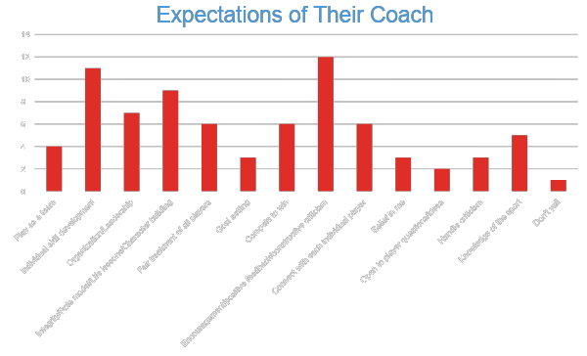

Slide 16
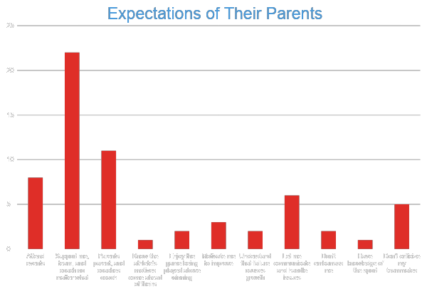

Slide 17
Can well intended parent involvement be detrimental?
Do You Dare To Chill?

Slide 18
Quote from one particular student…
I expect my coach(s) to lead with principles. I would expect them to lay out a set of expectations of how each player and coach are to act as a member of the team. I expect them to lead from the top down. And most importantly, how to teach us boys to become men. It's not just a seasonal thing in my opinion, a coach plays a very important role in a person's life, in and out of season, and even beyond high school.
Personally I would expect my parents to parent and my coach to coach. I would never want them to complain to the coaches or try to get them to fight my battles for me. The can talk with me and then I can address the coaches. I would expect my parents to respect me enough to listen to my requests.

Slide 19
Great Reminders from the MSHSL!!

Slide 20
GOALS VS PURPOSE
Goals are performance based
Winning games
Conference and section championships
Individual performance goals
Purpose is based on life lessons
Why a student plays
Why a coach coaches

Slide 21
New Athletic Trainer: Josie Lonning
I received my bachelors in Athletic Training from Lindenwood University and while there I was on the shotgun sports team and we were lucky enough to be 2x national champions.
I then came home to IA, and worked for NWIA Bone, Joint and Sports Surgeons for 4 years doing outreach athletic training at local high schools in the area.
Last year, I accepted a position with Mayo and am now excited to start with OMC and Pine Island.
I am not sure what my work email will be for contacting me yet, but I have always given my phone number out in the past if kids need to be seen as well, and that is 515-890-7747.

Slide 22
Let’s have a fantastic season! GO PANTHERS!!

